Slide 1

Course Introduction: Syllabus and Canvas Site
Richard S. Stansbury
CS 455/595a: Artificial Intelligence

Slide 2
Outline
Learning Outcomes
Course Syllabus Review
Canvas Site
Tools
Summary
Questions
References

Slide 3
Learning Outcomes
M0-L0: Explain the details of the course syllabus including goals, module topics, deliverables, grading, and course policies.
M0-L1: Navigate the CS 455/595a Canvas page including the Syllabus, Modules, Assignments, and Discussions tabs.

Slide 4
Course Syllabus

Slide 5

Instructor and Office
Instructor:
Richard S. Stansbury
Office: LB 346
Phone: 386-226-7923
Email: stansbur@erau.edu
Office Hours:
M, W, F 2-3pm
By Appointment

Slide 6
Course Description
This course provides an introduction to the basic concepts of artificial intelligence (AI) and machine learning (ML) with applications in business, technology, and engineering.
This course is introductory to the topic but assumes familiarity with a programming language.

Slide 7
Course Goals
Define common AI/ML algorithms and describe optimal use cases for each.
Translate problems in to suitable AI or ML problem formulations;
Collect and prepare data for the application of ML algorithms.
Implement or apply AI/ML algorithms in scripts and visual settings.
Interpret output from ML algorithms.
Understand hardware and performance considerations, and scale algorithms appropriately.
Identify pitfalls of common AI algorithms and ML models.
Understand the tradeoffs between performance and accuracy, and scale approach appropriately.
Verify results through cross-validation.

Slide 8
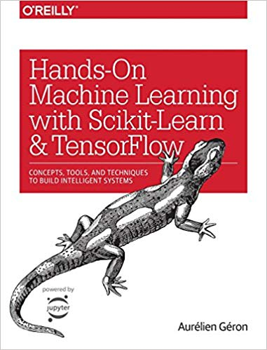
Textbook (required)
Aurelien Geron, Hands-On Machine Learning with Scikit-Learn & TensorFlow, O’Reilly: Sebastopol, CA, 2017.
Amazon.com Link: https://www.amazon.com/Hands-Machine-Learning-Scikit-Learn-TensorFlow/dp/1491962291
Image source: Amazon store page

Slide 9
Course Modules
Introduction
Search Algorithms
Genetic Algorithms
Introduction to ML and Classification
Training Models
Support Vector Machines
Decision Trees
Ensemble Learning and Random Forests
Introduction to Artificial Neural Networks
Convolutional Neural Networks
Recurrent Neural Networks
Reinforcement Learning

Slide 10
Grading
Canvas will house the official grade book for the course.
You can always check your posted grades.
Homework will be return graded within one week of the its submission.
Project deliverables and exams will be graded within two weeks.

Slide 11
Course Policies
CS 455 vs. CS 595a
Communication
This course is cross-listed for undergraduate (CS 455) and undergraduate students (CS 595a).
CS 595a students will be assigned additional tasks in the module assignments and the course project.
CS 455 students are welcome to also work on these tasks and receive written feedback on your work, but they will not be graded for credit.
Announcements:
Office course announcements will be made through the Canvas announcement’s page.
Please make sure your Canvas settings notify you of announcements either via email, on the web, or using the Canvas mobile app.
Phone/Email/Office Communication:
I will try to reply to all student emails within 24-hours.
I have an open-door policy so you are welcome to drop-in as needed when the door is open or during office hours.
I can be reached on my work number at either of my two offices (M-104 or LB 346).
I am typically in my Lehman office in the afternoon and when teaching.
Discussion Boards:
Course discussion boards are set-up to facilitate discussion of topics in the course and their assignments. Please review periodically.

Slide 12
Course Policies
Attendance
Late Policy
Attendance will not be formally taken in this class.
Some content covered during lecture that might not be available in the assigned reading or lecture materials online.
Failure to attend a scheduled exam or your final presentation will only be excused with a doctor’s note or a significant life-event.
Whenever possible, consulting with Dr. Stansbury prior to the absence would be advised.
Class will start promptly at 11am.
Tardiness should be avoided.
See late policy regarding timing for in-class deliverable submission.
Assignments are expected to be submitted by their due date/time.
Failure to submit by this time will result in:
-10% penalty for the first 24 hours,
-25% penalty for 24 – 48 hours,
-50% penalty thereafter up to the last day of classes for the term (i.e. prior to study day).
Work submitted in class should be submitted prior to the start of class at the instructor’s table/podium.
If you fail to submit prior to the start of lecture, it will be treated as late, and should be submitted once the lecture is complete.
Please do not interrupt the lecture.

Slide 13
Course Policies
This course follow’s the University’s academic integrity policy, which is available in the student handbook.
Please be mindful of plagiarism of online source code including free open source software.
Attribute the code appropriately identifying the original author and adhering to the source’s license agreement.
When in doubt, discuss with Dr. Stansbury please.
All assignments are to be done individually unless stated otherwise on the assignment. Penalties for academic misconduct can include: failure on the assignment, reduction of final grade by a letter grade, or failure of the course.

Slide 14
Course Canvas Site

Slide 15
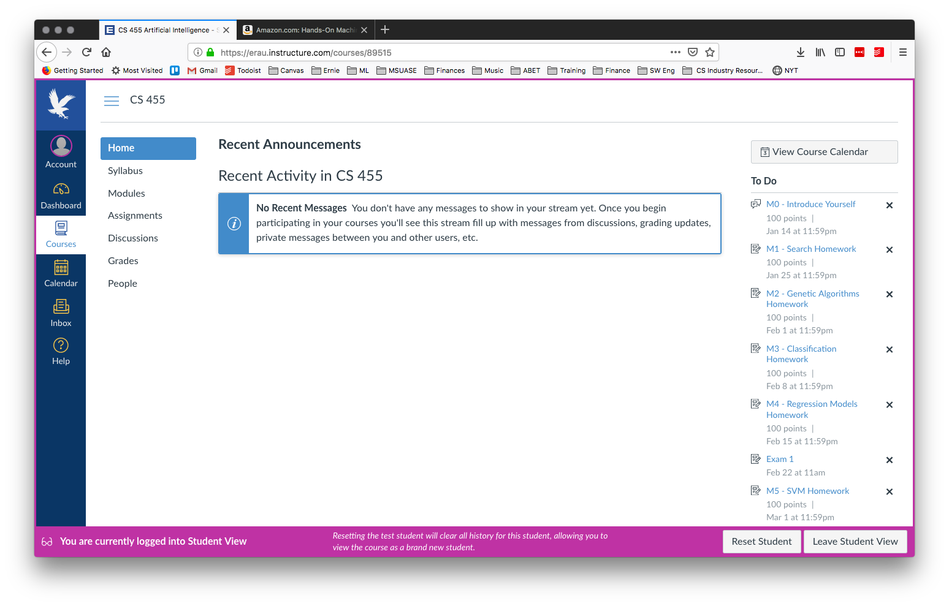

Slide 16
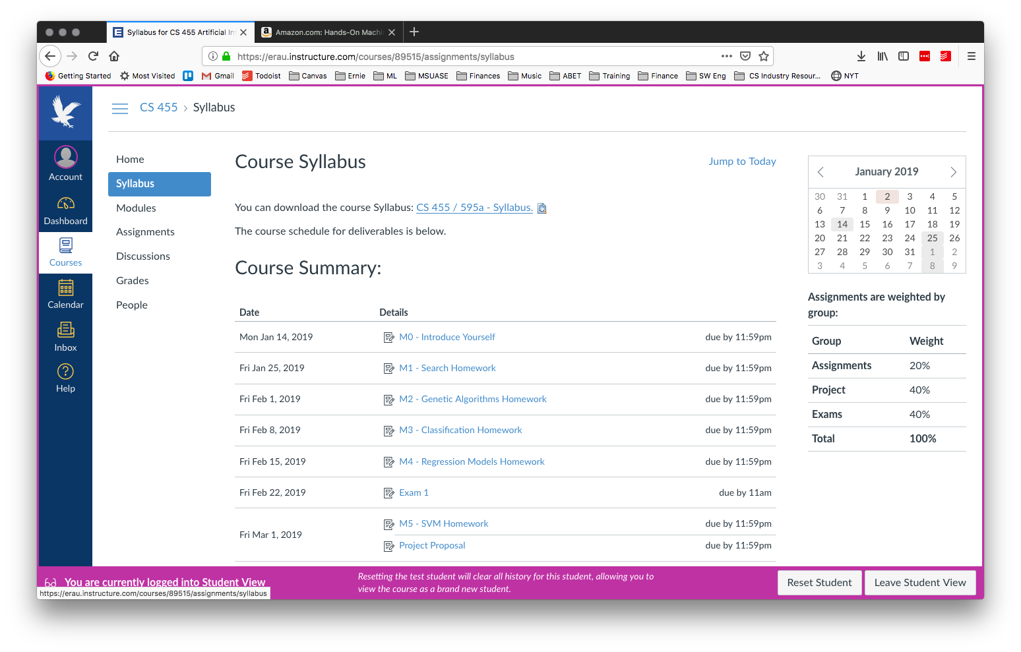

Slide 17
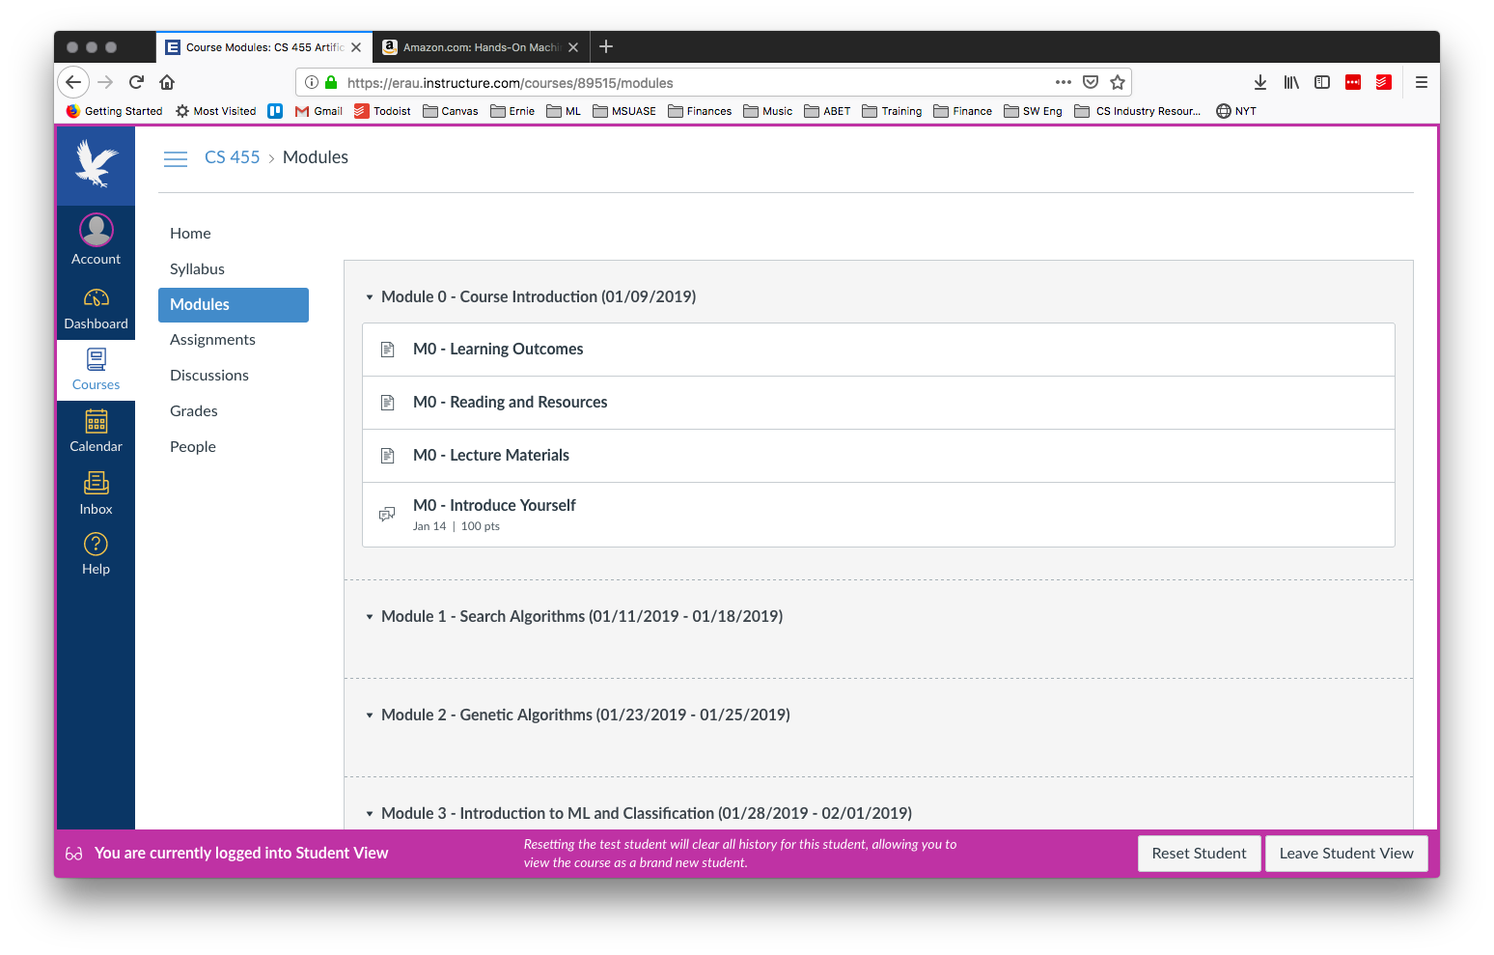

Slide 18
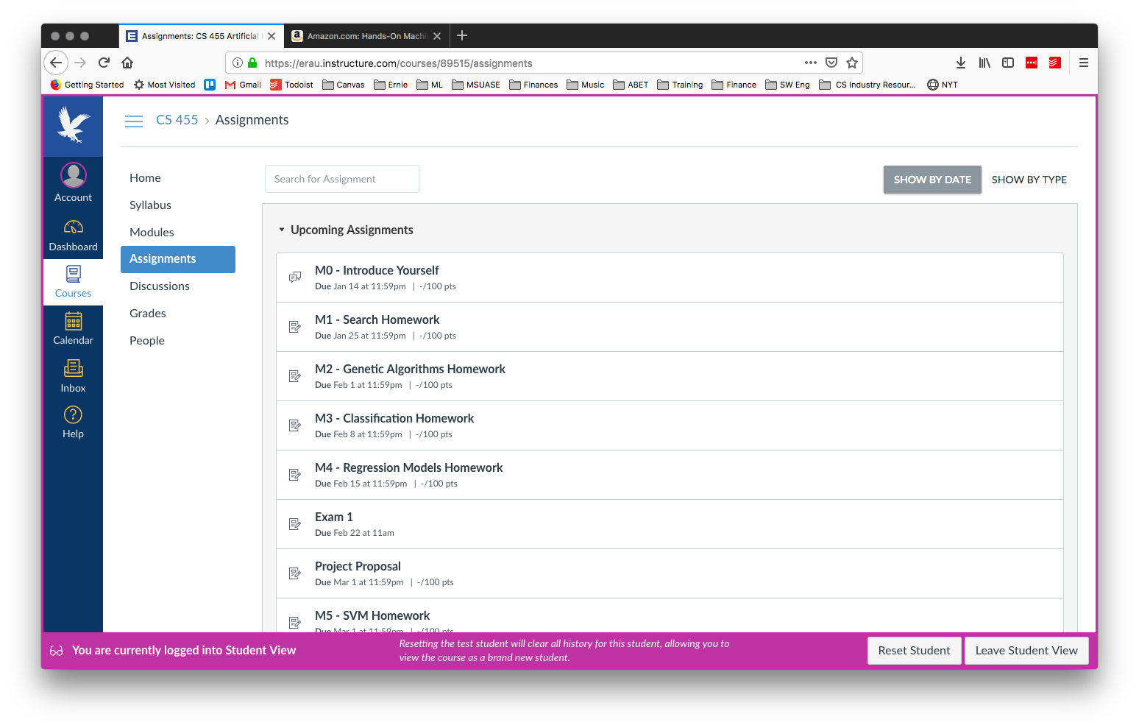

Slide 19
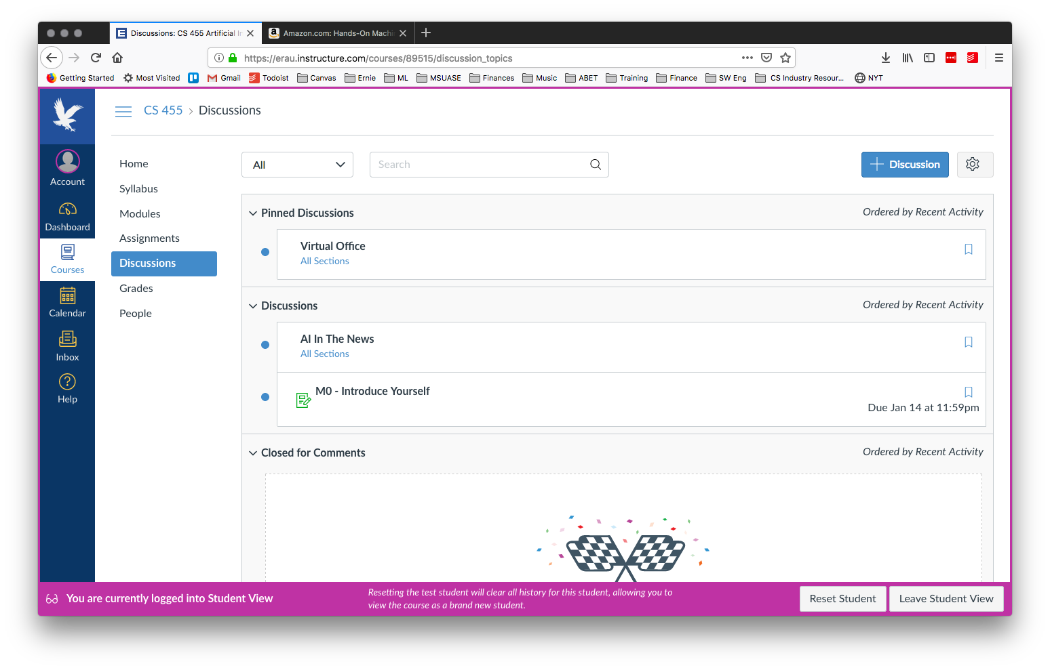

Slide 20
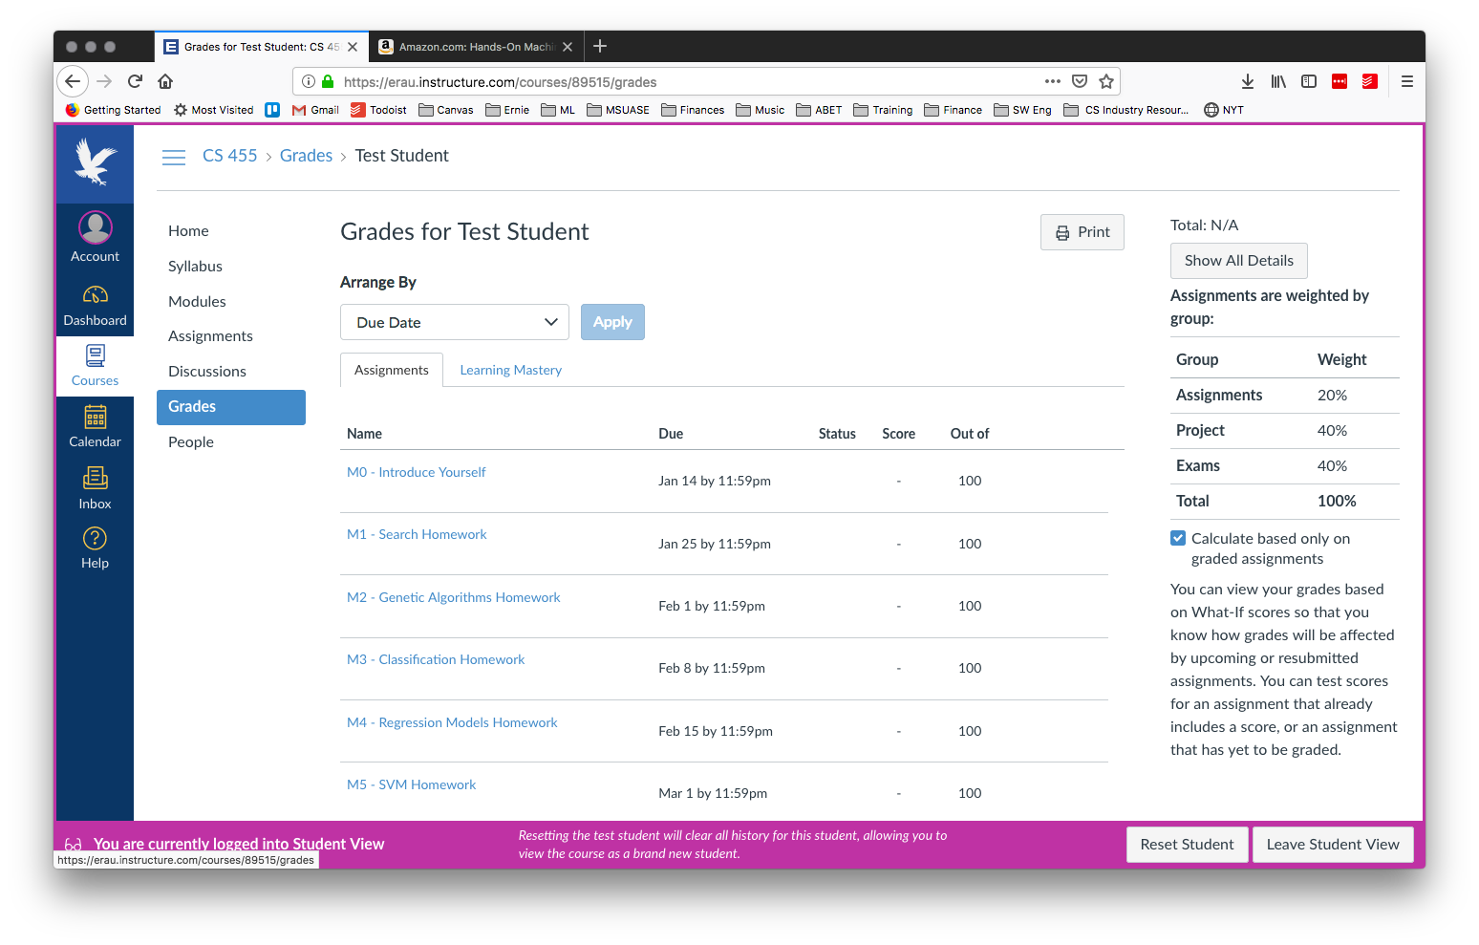

Slide 21
Tools

Slide 22
CS 455 Tools
Development will be done in Python 3.x programming language
AI/ML Libraries to be used include:
NumpPy
Scikit-Learn
Matplotlib
PANDAS
Coding examples will be shared through github and software projects must be managed and submitted via Github.
Jupyter Notebooks will be used for demos within the course and can be used for your own projects.
Google Colaboratory provides a free hosted solution for Jupyter notebooks with Google cloud GPU support

Slide 23
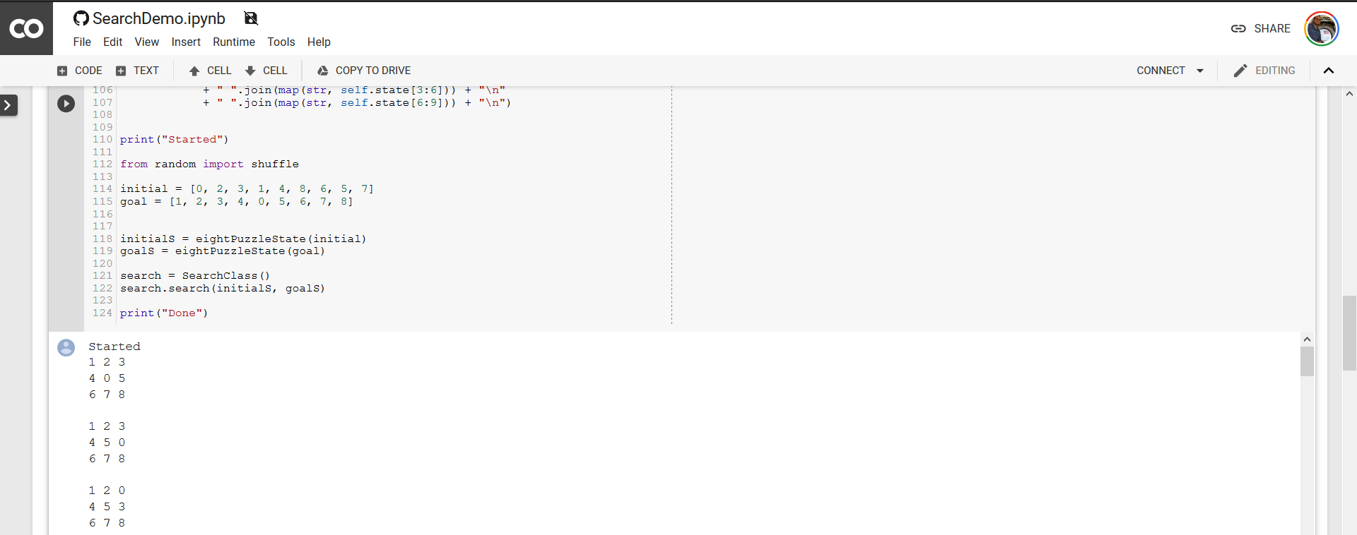
Example of Jupyter Notebook

Slide 24
Wrap-up

Slide 25
Summary
The Course Syllabus located on Canvas under the Syllabus tab provides an overview of course goals, modules, grading, and policies. Please consult this document as the official source.
Canvas will be the central hub of the course outside of lectures including:
Announcements
Learning modules
Assignments
Discussion Board
Grade Book
Development will be done within Python. Resources are available on Canvas to learn more about Python and the various libraries to be used.

Slide 26
Questions
Notes:
Image Source: https://svgsilh.com/image/1751308.html

Slide 27
References
N/A

